Slide 1


0
10
9
8
7
6
5
4
3
2
1

Slide 2

Robotics Corner

Slide 3
Robotics Corner
Linux
Linux is an open Source operating system that is widely used in most of the companies.

Slide 4
01
File archiving and compression (tar, gzip)
02
Text editors and text manipulation
AGEND
03
Processes and process management
04
Running and managing background processes
05
Redirecting input and output

Slide 5



Linux
File Operations and Processes
01285960031
01285960031
www.roboticscorner.tech

Slide 6
01
What is and why Linux
File archiving and compression
To compress a file in Linux: tar -zcvf file.tar.gz [PATH]
ex: tar -zcvf file.tar.gz file.cpp
-c: Create a new archive.
-z: Compress the archive using gzip.
-v: Verbose mode (optional, shows the progress).
-f: Specifies the archive file name.
01285960031
01285960031
www.roboticscorner.tech

Slide 7
01
What is and why Linux
exclude directories and files
Compress files but excluding files: tar -zcvf archive.tar.gz --exclude=’[DIRECTORY]’
Compress files but excluding directories: tar -czvf /nfs/backup.tar.gz --exclude=" DIRECTORY " /home/vivek/
01285960031
01285960031
www.roboticscorner.tech

Slide 8
01
What is and why Linux
Extract a file
tar -xzvf file.tar.gz
tar -xjvf file.tar.bz2
extract the contents of the archive into a specific directory: tar -xzvf my.tar.gz -C [DIRECTORY]
tar -xjvf archive.tar.bz2 -C [DIRECTORY]
01285960031
01285960031
www.roboticscorner.tech

Slide 9
01
What is and why Linux
Extract a file
-x : Extract files from an archive
-t : List the contents of an archive
-v : Verbose output
-f file.tar.gz : Use archive file
-C DIR : Change to DIR before performing any operations
--exclude : Exclude files matching PATTERN/DIR/FILENAME
01285960031
01285960031
www.roboticscorner.tech

Slide 10
02
Text editors and text manipulation
Text Editors in Linux
Text Editor: nano
If you already have a txt file: nano _text_file_name.txt
CRTL + O → to save
CTRL + X → to exit
01285960031
01285960031
www.roboticscorner.tech

Slide 11
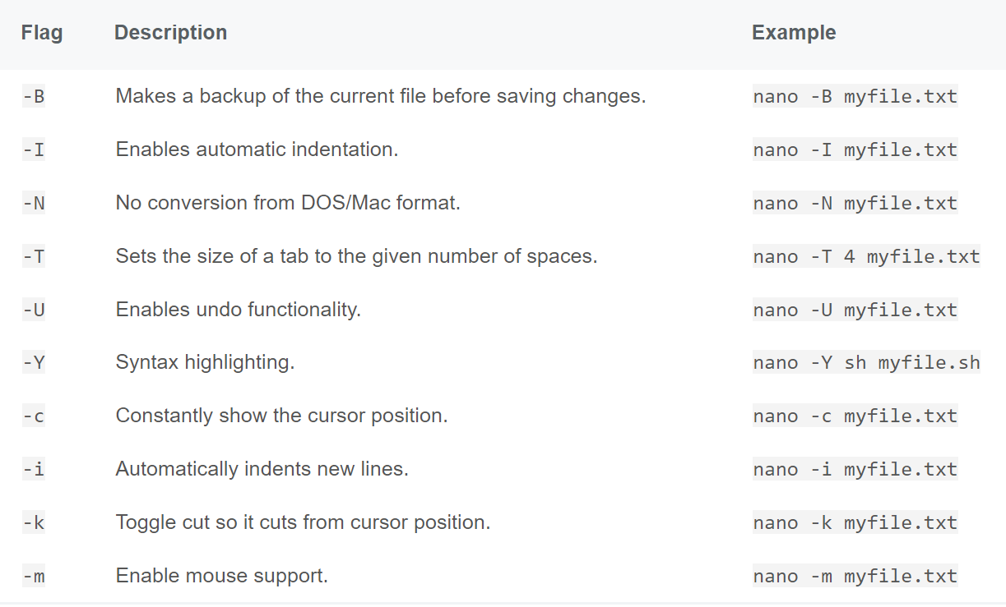
02
Text editors and text manipulation
Nano
01285960031
01285960031
www.roboticscorner.tech

Slide 12
02
Text editors and text manipulation
Other text editors
While the nano command is a powerful and user-friendly text editor, Linux provides other text editors that might better suit your needs, particularly as you become more experienced. Two of the most popular alternatives are Vi and Emacs.
01285960031
01285960031
www.roboticscorner.tech

Slide 13
02
Text editors and text manipulation
VI
vi myfile.txt
a. press 'i' to enter insert mode
ex: This is some text.
c. press 'Esc' to exit insert mode
d. type ':wq' to save and quit
e. Output: 'myfile.txt' 1L, 18C written
01285960031
01285960031
www.roboticscorner.tech

Slide 14
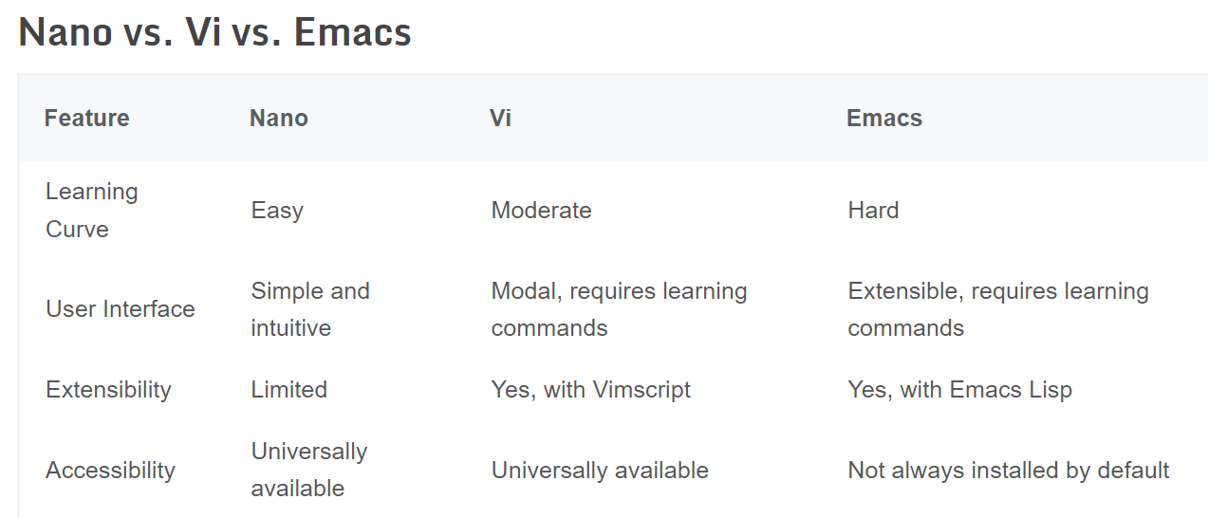
02
Text editors and text manipulation
01285960031
01285960031
www.roboticscorner.tech

Slide 15
02
Text editors and text manipulation
Basic text manipulation
1. grep
2. cat
3. less
4. head
5. tail
01285960031
01285960031
www.roboticscorner.tech

Slide 16
02
Text editors and text manipulation
grep
The grep filter searches a file for a particular pattern of characters and displays all lines that contain that pattern. The pattern that is searched in the file is referred to as the regular expression (grep stands for global search for regular expression and printout).
grep [options] pattern [files]
[options]: These are command-line flags that modify the behavior of grep.
[pattern]: This is the regular expression you want to search for.
01285960031
01285960031
www.roboticscorner.tech

Slide 17
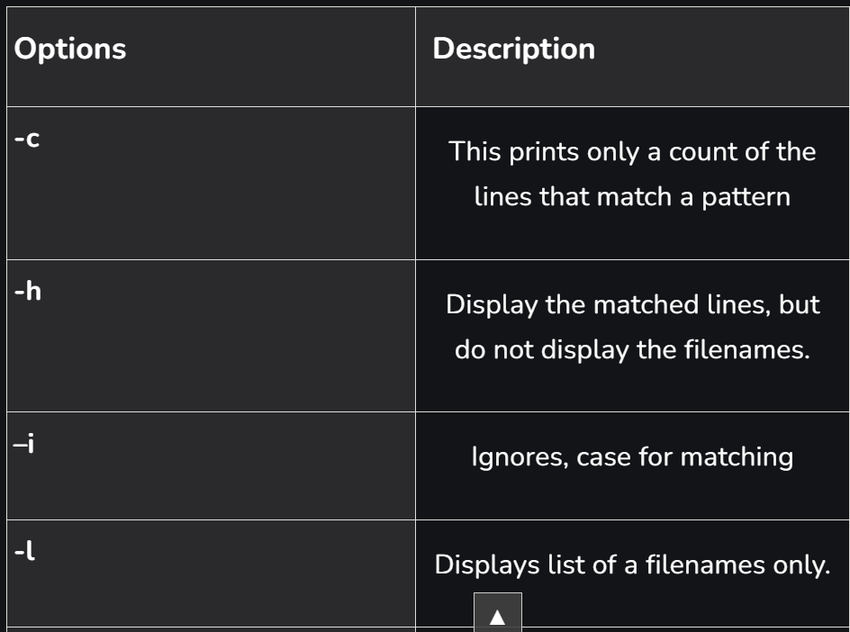
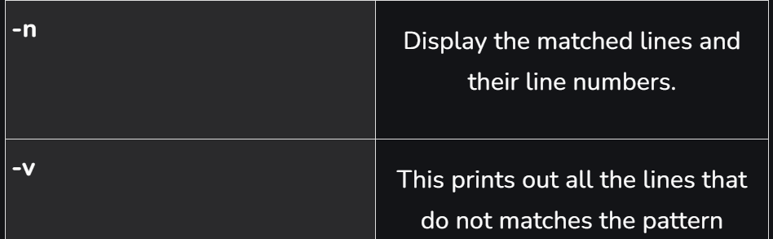
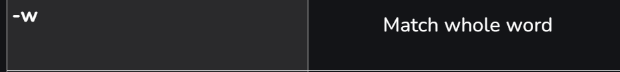
02
Text editors and text manipulation
grep
01285960031
01285960031
www.roboticscorner.tech

Slide 18
02
Text editors and text manipulation
Cat, less
The cat command is the simplest way to view the contents of a file. It displays the contents of the file(s) specified on to the output terminal. Used for simple and short files: cat FILENAME
The less command is similar to the more command but provides extensive features. One important one is that it allows backward as well as forward movement in the file: less FILENAME
Use g and G to go up or down, q to exit
01285960031
01285960031
www.roboticscorner.tech

Slide 19
02
Text editors and text manipulation
Head, tail
As their names imply, the head command will output the first part of the file, while the tail command will print the last part of the file. Both commands write the result to standard output: head [OPTIONS] FILES
Both allow the display of a certain number of lines
tail [OPTIONS] FILES
01285960031
01285960031
www.roboticscorner.tech

Slide 20
03
Processes and process management
Processes and process management are fundamental concepts in Linux and other operating systems. Understanding and effectively managing processes is crucial for the stability, performance, and security of a Linux system.
A process is an instance of a program currently running on a computer system. In Linux, processes are managed by the operating system's kernel, which allocates system resources and schedules processes to run on the CPU. Understanding and managing processes is a critical skill for Linux administrators and developers.
01285960031
01285960031
www.roboticscorner.tech

Slide 21
03
Processes and process management
ps
Sometimes, we want to close unresponsive programs or check if a background process has started in our Linux system.
The ps command in Linux is used for displaying information about processes. It provides a snapshot of the currently running processes on the system. The ps command has various options that allow you to customize the output according to your requirements: ps [options]
PID – the process id
TTY – terminal associated with the process
TIME – elapsed CPU utilization time for the process
CMD – the executable command
01285960031
01285960031
www.roboticscorner.tech

Slide 22
03
Processes and process management
top, kill
Top is used to list all running Linux processes on your system: top
To kill a process: kill [PID]
01285960031
01285960031
www.roboticscorner.tech

Slide 23
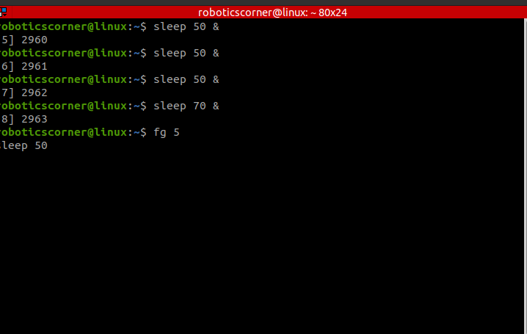
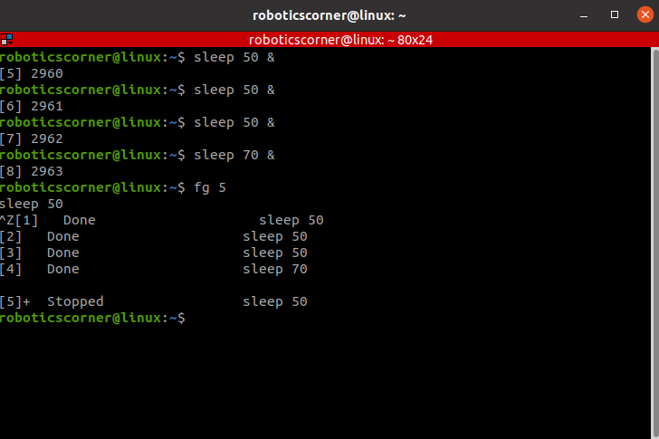
04
Running and managing background processes
01285960031
01285960031
www.roboticscorner.tech

Slide 24
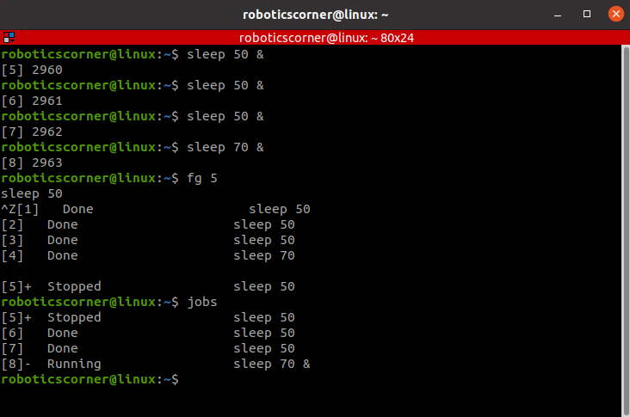
04
Running and managing background processes
01285960031
01285960031
www.roboticscorner.tech

Slide 25
04
Running and managing background processes
echo
The echo command is a way to communicate with your Linux terminal. It allows you to send text, variables, and special characters to the standard output, which is usually the terminal screen. The echo command is like a messenger that delivers your words to the terminal.
01285960031
01285960031
www.roboticscorner.tech

Slide 26
05
Redirecting input and output
The ‘>‘ symbol is used for output (STDOUT) redirection overriding the file: > : ls –al > record.txt
If the contents of the file are to be added and not overwritten: >> : ls –n text >> record.txt
The ‘<‘ symbol is used for input(STDIN) redirection : Mail -s "Subject" to-address < Filename
01285960031
01285960031
www.roboticscorner.tech

Slide 27
05
Redirecting input and output
|
In Linux, the vertical bar (|) is known as a "pipe" and is used to connect the output of one command to the input of another. This allows you to create a pipeline of commands, where the output of one command becomes the input for the next command. The | symbol is commonly used in the command line to enhance the functionality and flexibility of Linux commands.
01285960031
01285960031
www.roboticscorner.tech

Slide 28
05
Redirecting input and output
Word count
wc [file]: returns is the file's number of lines, words, and characters, followed by its path.
01285960031
01285960031
www.roboticscorner.tech

Slide 29
05
Redirecting input and output
Diff command
Its primary purpose is to compare the contents of two files and display their differences. diff [FILE1] [FILE2]
Can compare 2 versions of the same file
01285960031
01285960031
www.roboticscorner.tech

Slide 30


Slide 31

01211626904
www.roboticscorner.tech
Robotics Corner
Robotics Corner
Robotics Corner
Robotics Corner

